Slide 1

Channel coding for reliable digital transmission
Adding some extra bits to each message will help in combating noise .
Example:
single parity check code :
ex : 1100 0 even parity
if received 11100 parity is odd , then , there is error

Slide 2

1- why channel coding
Having constrains preventing having a signal scheme with an acceptable Pe so use of channel coding ( in 1948 shannon demonstrated that by proper encoding od the information, errors induced in the channel can be greatly reduced.

Slide 3

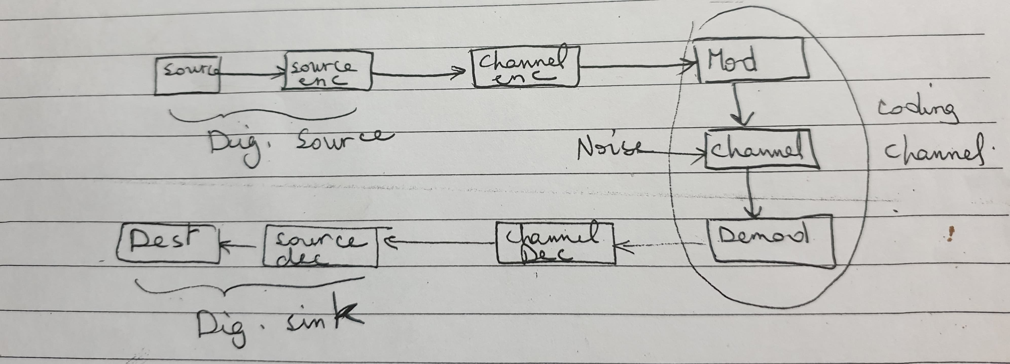
A typical transmission system B.D.

Slide 4

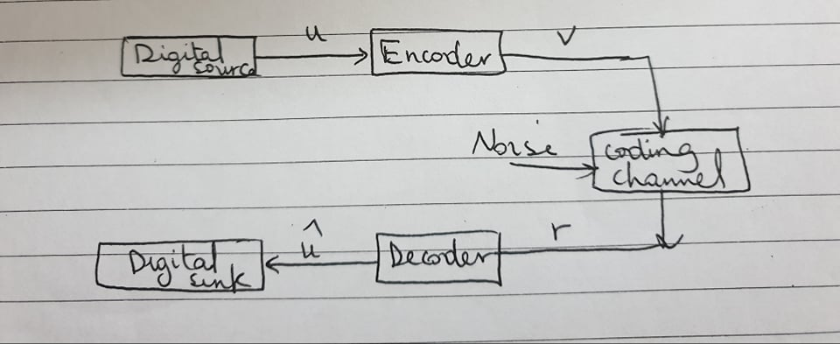
Simplified to

Slide 5

Now the problem is to design an enc. & a decoder such that :
1- inf. Can be transmitted in a noisy environment as fast as possible.
2- reliable reproduction of the inf. can be obtained at the output of the decoder
3- the implementation cost of the enc. & dec. falls into acceptable limits.

Slide 6

2- types of codes:
block codes : ( studied in the next lecture )
convolutional codes
In both codes the encoder divides the information source output into message blocks of length k bits each ( u= u₁,u₂,…..u_{k} ) called a k-tuple message (2^{k} different possible messages are available.

Slide 7
3- maximum likelihood decoding:
how to decode the coming word to the receiver ? Producing an estimate û of the information sequence u transmitted
this is done by minimizing the distance d(r,v) between r & v ; that is chooses the codeword that differs from the received sequence in the fewest number of positions .
distance between 2 c.w.s= number of bit locations in which they differ:
S₁= 101101 s₂= 100111 d(s₁,s₂)=2

Slide 8

4- types of errors:
Transmission errors in a digital communication system are caused by noise
generally, 2 kinds of noise can be distinguished in a communication channel:
Gaussian noise random errors
Impulse noise burst errors

Slide 9
5- error control strategies:
One way communication system FEC
Two way communication system ARQ

